Slide 1
Aerial Pathfinding Reconnaissance
Jason Gilman, Max Griffith, Mark Johnson, Dilanka Weerasinghe

Slide 2
Background
Observation: Autonomous vehicles suffer from a variety of issues:
Ground vehicles rely heavily on expensive sensors.
Aerial drones lack meaningful capacity.
Solution: Combine strengths with a hybrid approach.

Slide 3
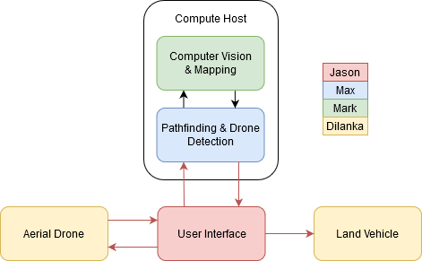
Overview
To prototype this relationship, we have developed this architecture:
Four distinct elements
Aerial drone
Land drone
User interface
Compute host
Goal: Use aerial recon to navigate an otherwise-blind vehicle.

Slide 4
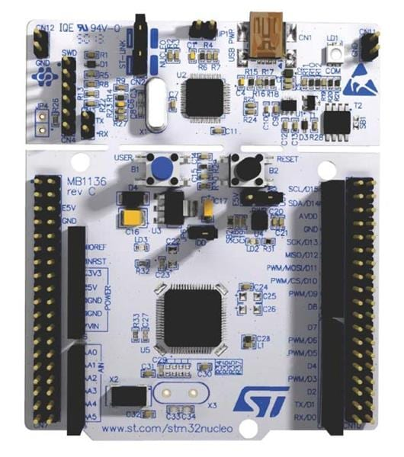

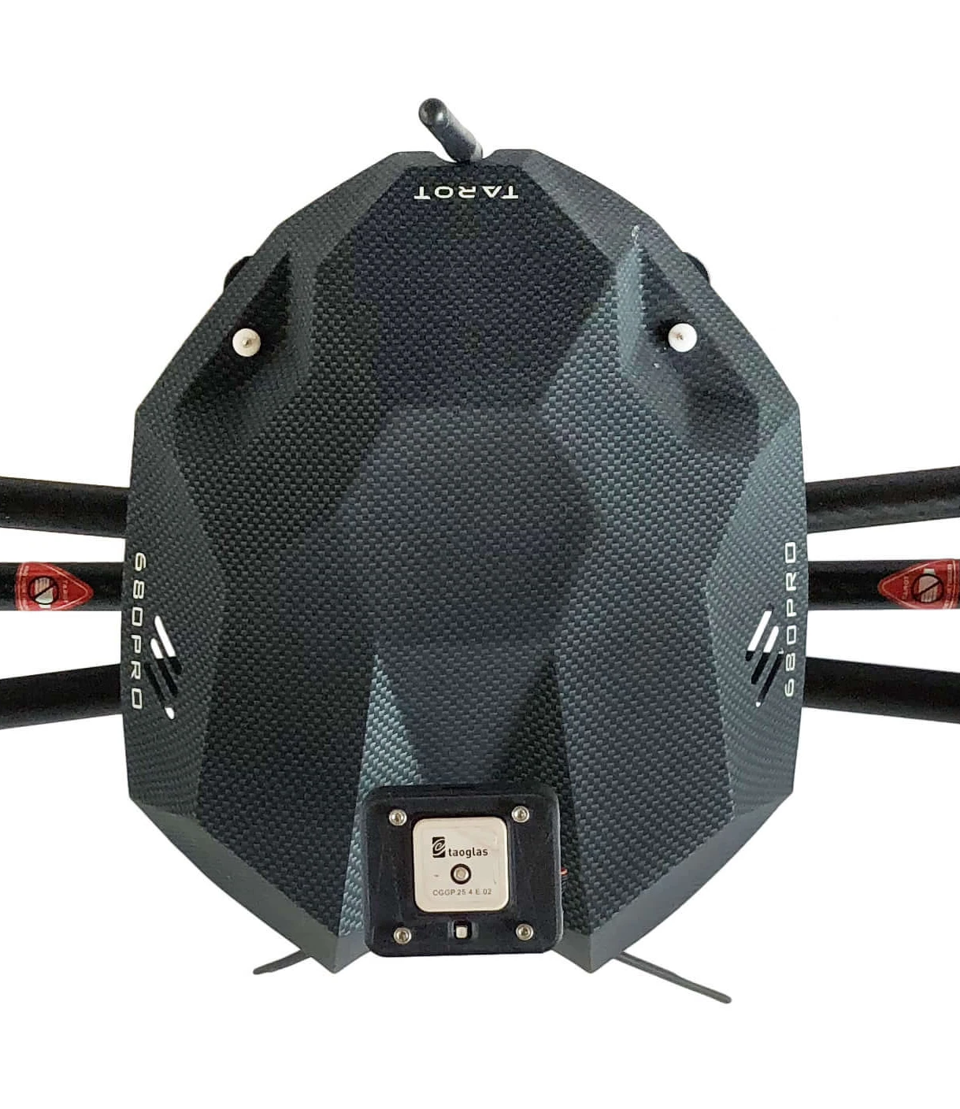
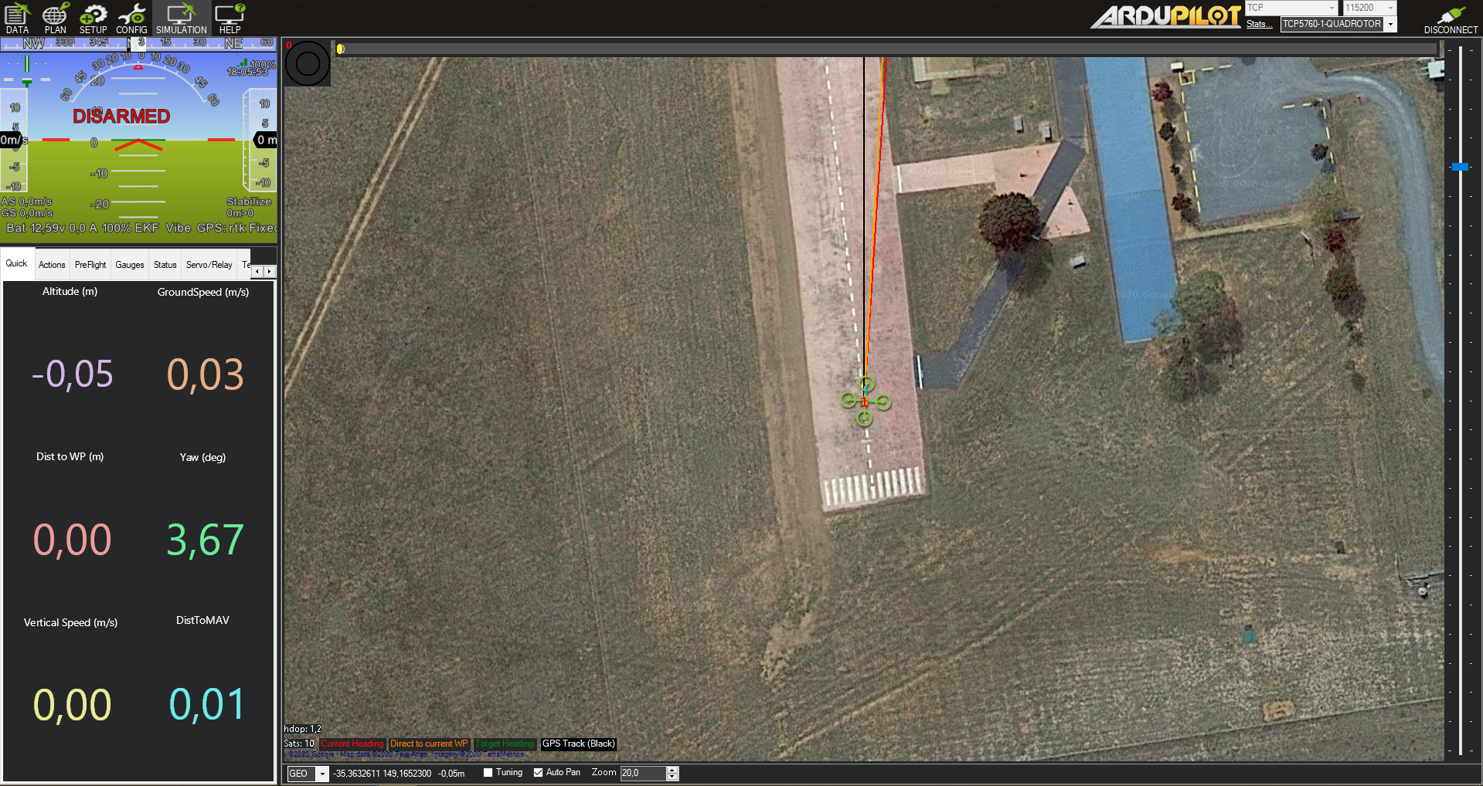
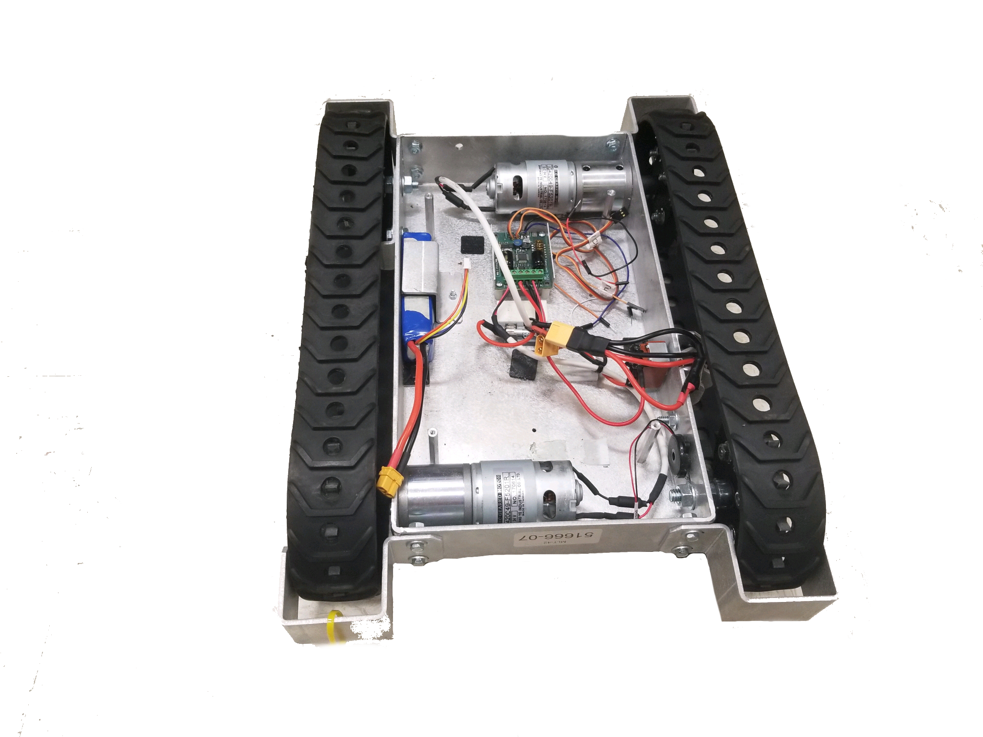
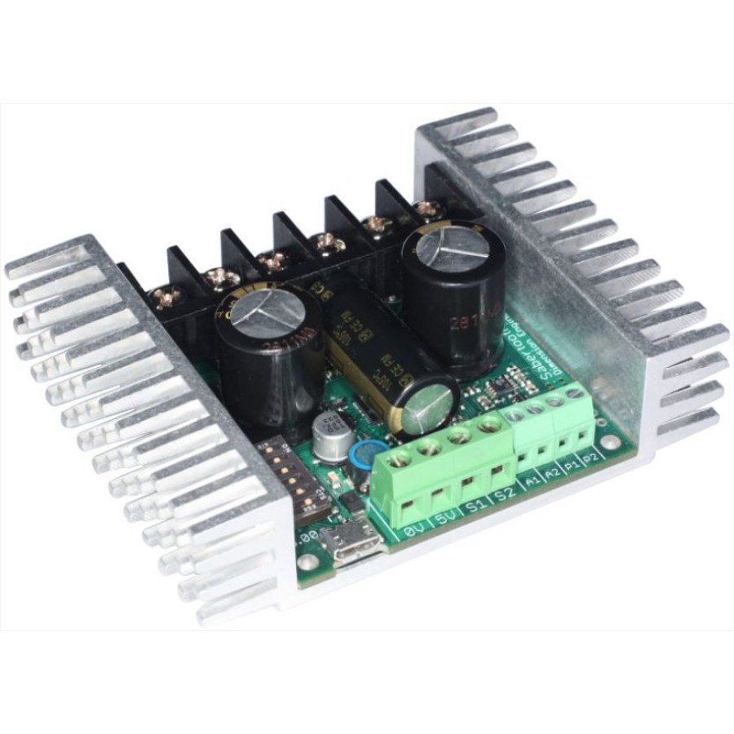
Data Collection & Drone Control
Microcontroller
Use stm32 to control Pixhawk flight controller and onboard mapping sensors.
Subsystem will gather telemetry and imaging data to relay to desktop application.
Using ArduPilot Mission Planner to monitor drone and set path.
After processing Land drone will follow path.
Ultrasonic sensors for object avoidance
stm32 Nucleo with to Pixhawk controller

Slide 5
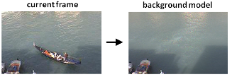
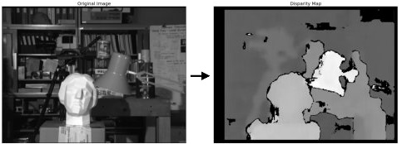
Computer Vision & Mapping
Four step approach:
Filter out moving objects
Infer depth from stereographic views
Derive an elevation differential field
Delineate obstacles by vehicle parameters
Focus is on avoiding a pure ML solution. Why?
Reduces runtime compute cost
Allows for configurability
(No black-box design!)
Images adapted from OpenCV documentation

Slide 6
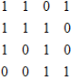
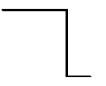
Pathfinding & Drone Detection
Input Boolean map
Input Color Image
Search image for drone and decide distances of indices
Design greedy algorithm to specify path taken by drone
Use specified path to send drone instructions for land movement
Why greedy algorithm?
Save runtime cost of program

Slide 7

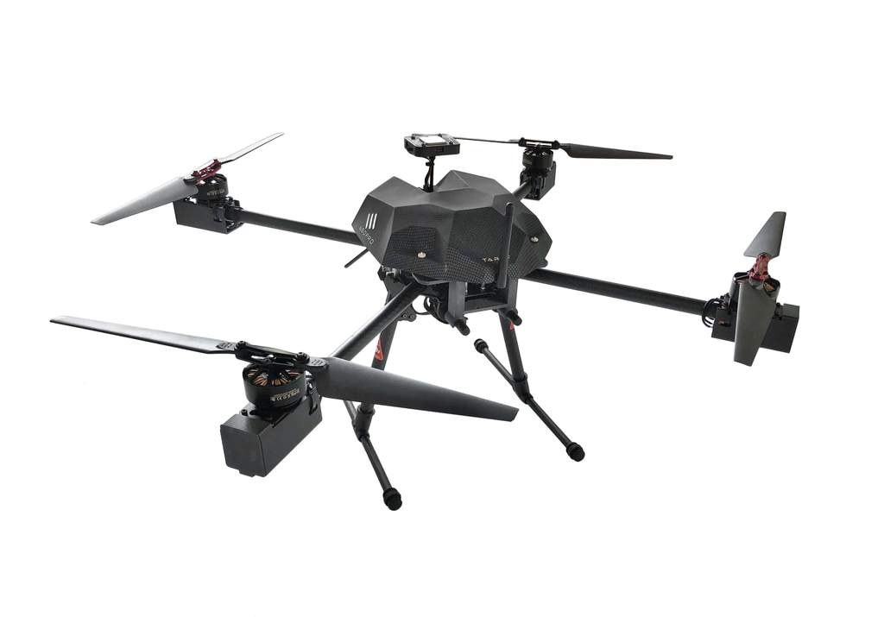

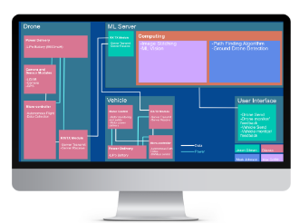
Device Networking & UI
UI integrated into desktop application
Communication through wireless local area networks
Optional utilization of TAMU GPU servers

Slide 8
Execution & Validation Plans
Execution plan divided into week by week milestones
Unit tests created for validation plan
Subsystem | Week 7 5-Oct-20 | Week 9 19-Oct-20 | Week 11 2-Nov-20 | Week 14 23-Nov-20
Data Collection & Drone Control Dilanka | Finalize and order parts | Aerial and land drones built | Data retrieval from aerial drone | Autonomous drone flight
Computer Vision & Mapping Mark | Estimate depth on path sections | Merge depth estimates with map | Derive gradient field from elevation map | Implement obstacle delineation
Pathfinding & Drone Detection Max | Increased python coding skills | Error handling for path detection | Program movement of land drone | Land drone path mapped and instructions created
Device Networking & UI Jason | Basic client/server interaction | Flight mapping functionality | Communication with drone servers | Package software/create installer
*High-level milestones adapted from Execution Plan

Slide 9
Questions?

